Slide 1

Machine learning for adsorption isotherm data extraction
Julia chotoo

Slide 2
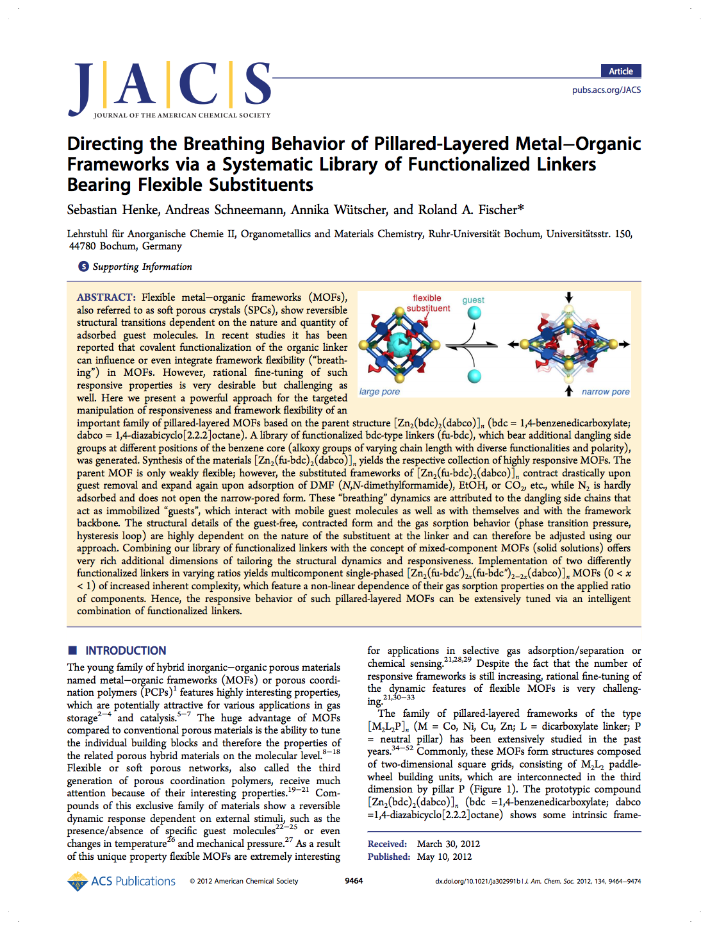
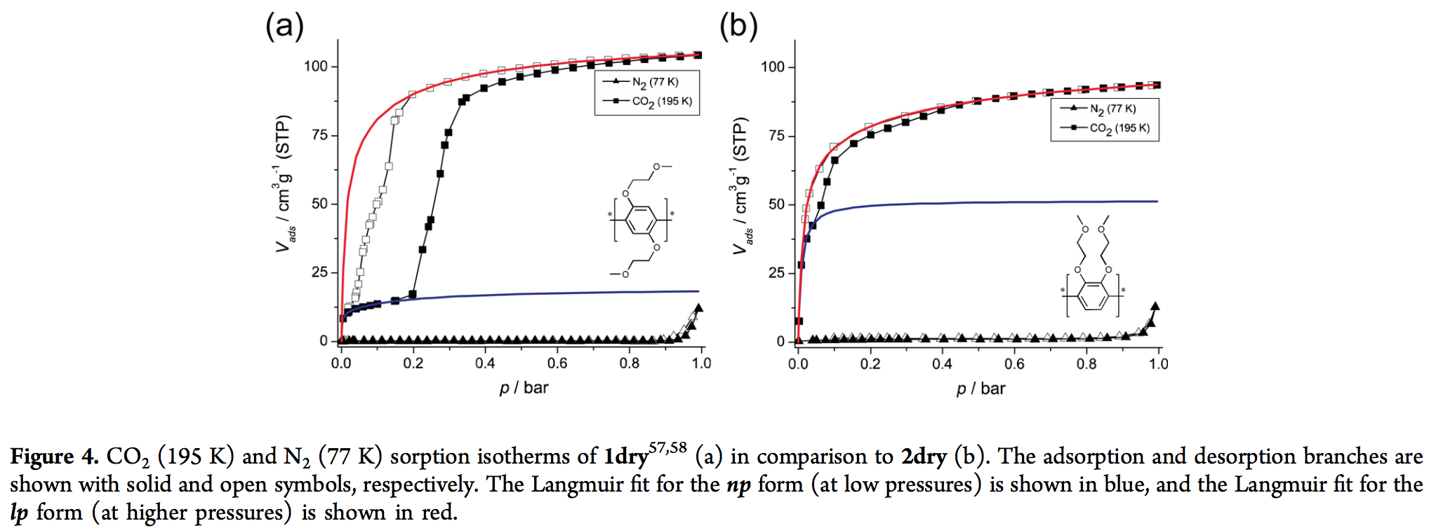
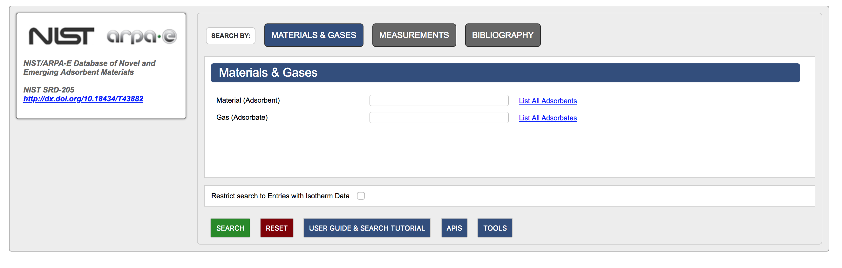
Notes:
I started at NIST (National Institute of Standards and Technology) in the summer of 2017 in their Summer High School Internship Program. One of my tasks was to digitize isotherms. My mentor gave me a digital library with a bunch of articles to look through. I had to read through the articles, and if it contained isotherms I had to digitize them by hand and enter all the metadata associated with the isotherm into the database. Manually entering this data is prone to human errors. Automation of this process would reduce these errors.

Slide 3

Adsorption – enrichment of one or more components in an interfacial layer
2. Adsorbate – substance in the adsorbed state
3. Adsorbent – solid material on which adsorption occurs
Adsorbate(s)
https://simple.wikipedia.org/wiki/Adsorption

Slide 4
y-axis: amount adsorbed
x-axis: pressure or mole fraction
Adsorption Isotherm – a curve on a diagram joining points representing states or conditions of equal temperature; the amount adsorbed will be recorded over changing pressure or change amount of adsorbate in multicomponent adsorption

Slide 5
Why is adsorption important?
Commercial and industrial applications for adsorption are wide ranging, including removal of excess CO₂ from flue gas streams and solid-based chemical separations (as alternative to thermal separations like distillation)
Database aids in future research and development by giving researchers and companies data to compare to

Slide 6
Goal: automate part of data extraction process
Automate the process of retrieving the full Hypertext Markup Language (HTML) text of a journal article
Automatically determine if a journal article contains adsorption isotherm data and what type of isotherm data it contains
Automate the extraction of additional information, metadata, needed for each isotherm. This includes adsorbent, adsorbate, temperature, pressure units, adsorption units, the location of the isotherm data within the paper, and if the isotherm is single-component or multicomponent.

Slide 7
Automatic retrieval of full html text

Slide 8
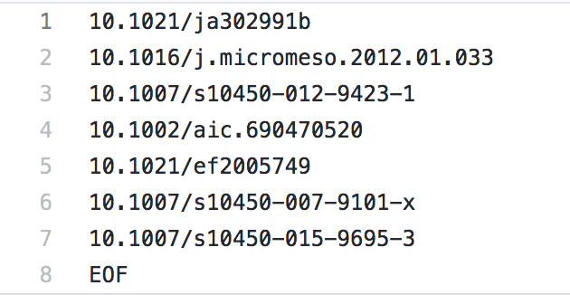
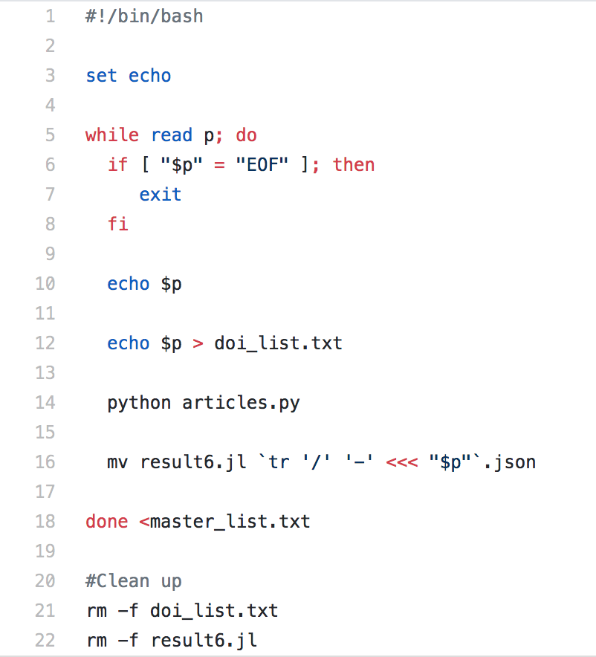
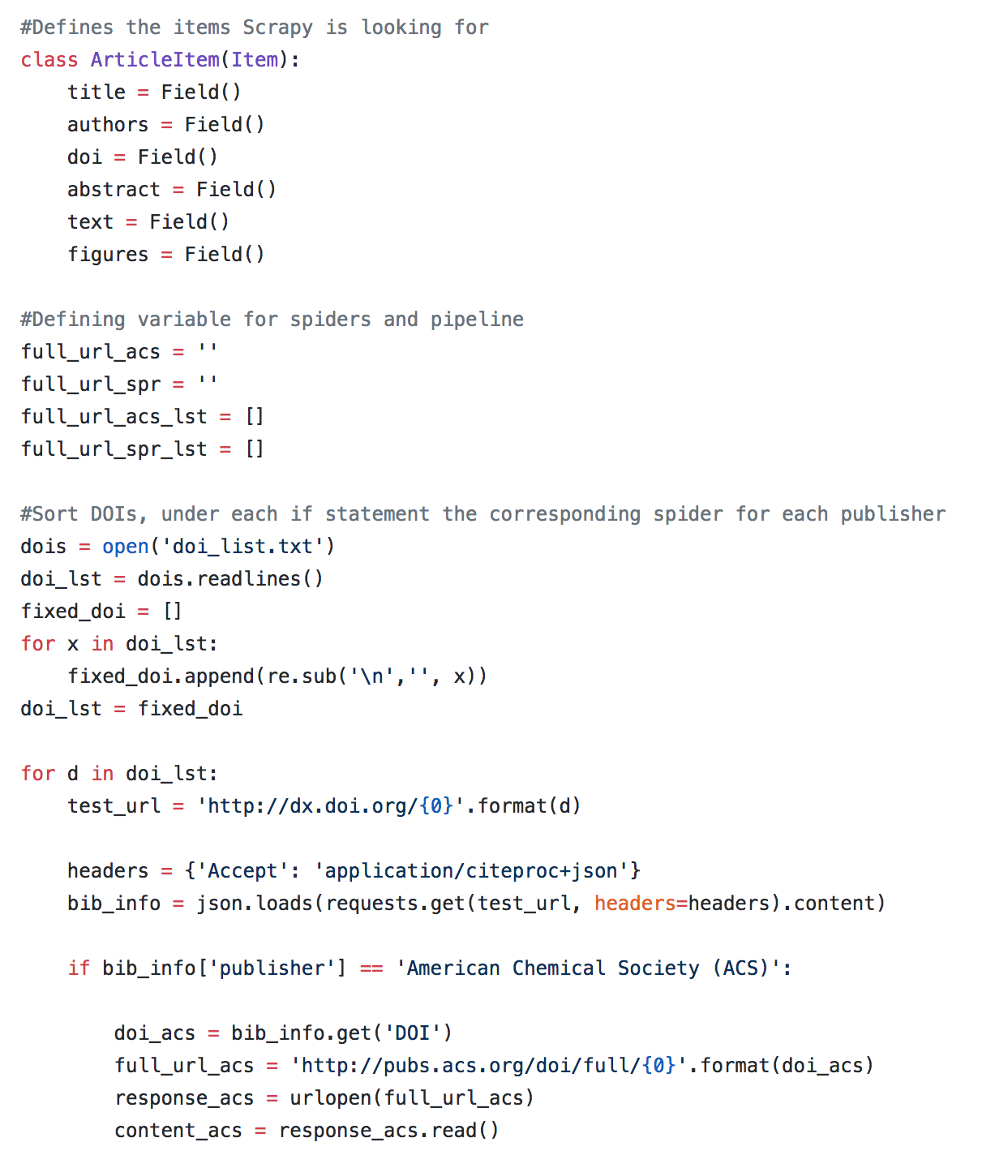
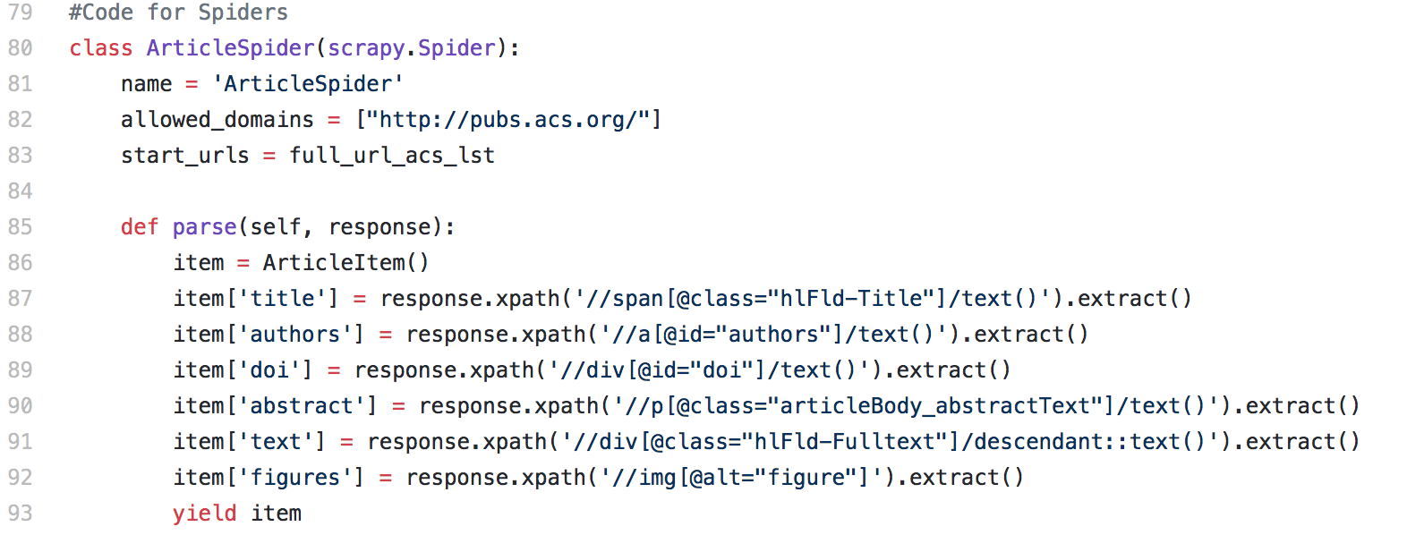
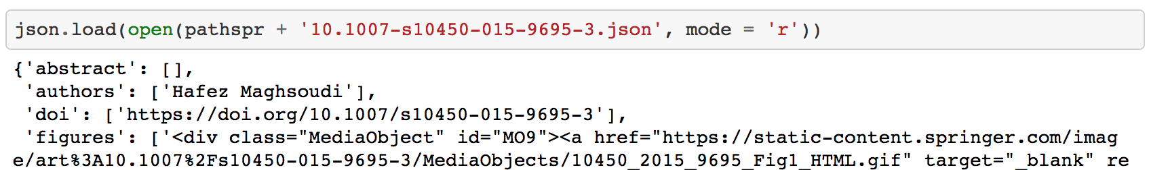
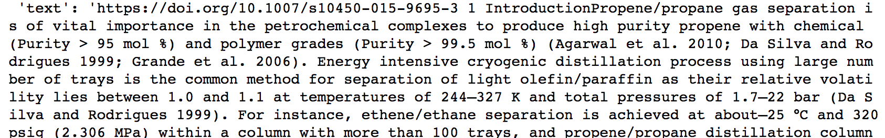
List of DOIs
Bash Loop to Run Code
Code to Scrape Webpages
Returned JSON File
JSON File with Processed Text

Slide 9
Classification of Articles

Slide 10
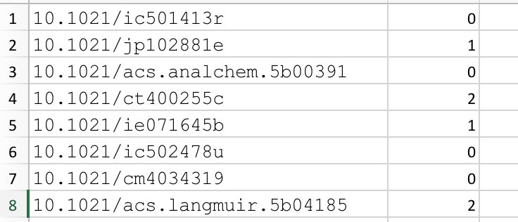
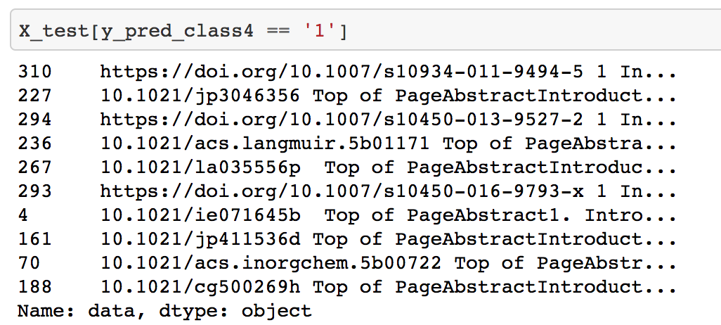
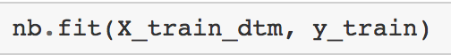
Labeled Data
Split Data
Vectorize Text
Run
Run
Runner
3
Running
Predict
Learn
Run Algorithms
Multinomial Naive Bayes
Logistic Regression
Support Vector Classifier
Decision Tree with AdaBoost
Labeled data (multicomponent, singlecomponent, no isotherm data)
Divided the data into training (~75%) and testing (~25%) data
Tokenized the article into words (words with the same stem were the same token) and removed stop words (words that were not important to the meaning of the text)
Fit and transformed training data to a vector. Transformed testing data to a vector.
Fit training data to Multinomial Naïve Bayes algorithm from Sklearn
Used Multinomial Naïve Bayes algorithm to predict the labels for the testing data
Labeled data (multicomponent, singlecomponent, no isotherm data)
Divided the data into training (~75%) and testing (~25%) data
Tokenized the article into words (words with the same stem were the same token) and removed stop words (words that were not important to the meaning of the text)
Fit and transformed training data to a vector. Transformed testing data to a vector.
Fit training data to Multinomial Naïve Bayes algorithm from Sklearn
Used Multinomial Naïve Bayes algorithm to predict the labels for the testing data
Labeled data (isotherm data present, no isotherm data)
Labeled data (multicomponent, singlecomponent, no isotherm data)
Divided the data into training (~75%) and testing (~25%) data
Tokenized the article into words (words with the same stem were the same token) and removed stop words (words that were not important to the meaning of the text)
Fit and transformed training data to a vector. Transformed testing data to a vector.
Fit training data to Multinomial Naïve Bayes algorithm from Sklearn
Used Multinomial Naïve Bayes algorithm to predict the labels for the testing data
Labeled data (isotherm data present, no isotherm data)
Labeled data (multicomponent, singlecomponent, no isotherm data)
Divided the data into training (~75%) and testing (~25%) data
Tokenized the article into words (words with the same stem were the same token) and removed stop words (words that were not important to the meaning of the text)
Fit and transformed training data to a vector. Transformed testing data to a vector.
Fit training data to Multinomial Naïve Bayes algorithm from Sklearn
Used Multinomial Naïve Bayes algorithm to predict the labels for the testing data
Labeled data (isotherm data present, no isotherm data)
Labeled data (multicomponent, singlecomponent, no isotherm data)
Divided the data into training (~75%) and testing (~25%) data
Tokenized the article into words (words with the same stem were the same token) and removed stop words (words that were not important to the meaning of the text)
Fit and transformed training data to a vector. Transformed testing data to a vector.
Fit training data to Multinomial Naïve Bayes algorithm from Sklearn
Used Multinomial Naïve Bayes algorithm to predict the labels for the testing data
Fit and predicted for Logistic Regression, Support Vector Classifier, and Decision Tree with AdaBoost algorithm
Fit and predicted for Logistic Regression, Support Vector Classifier, and Decision Tree with AdaBoost algorithm
Fit and predicted for Logistic Regression, Support Vector Classifier, and Decision Tree with AdaBoost algorithm

Slide 11
Binary classification
Tertiary classification
Accuracy
Algorithm | Accuracy
Multinomial Naïve Bayes | 0.8734
Logistic Regression | 0.8608
Support Vector Classifier | 0.9241
Decision Tree with AdaBoost | 0.9241
Accuracy
Algorithm | Accuracy
Multinomial Naïve Bayes | 0.7594
Logistic Regression | 0.7881
Support Vector Classifier | 0.8354
Decision Tree with AdaBoost | 0.8861
Highest accuracy of classification
Null Accuracy = 0.7848
Null Accuracy = 0.6582

Slide 12
Locating isotherms in the text

Slide 13
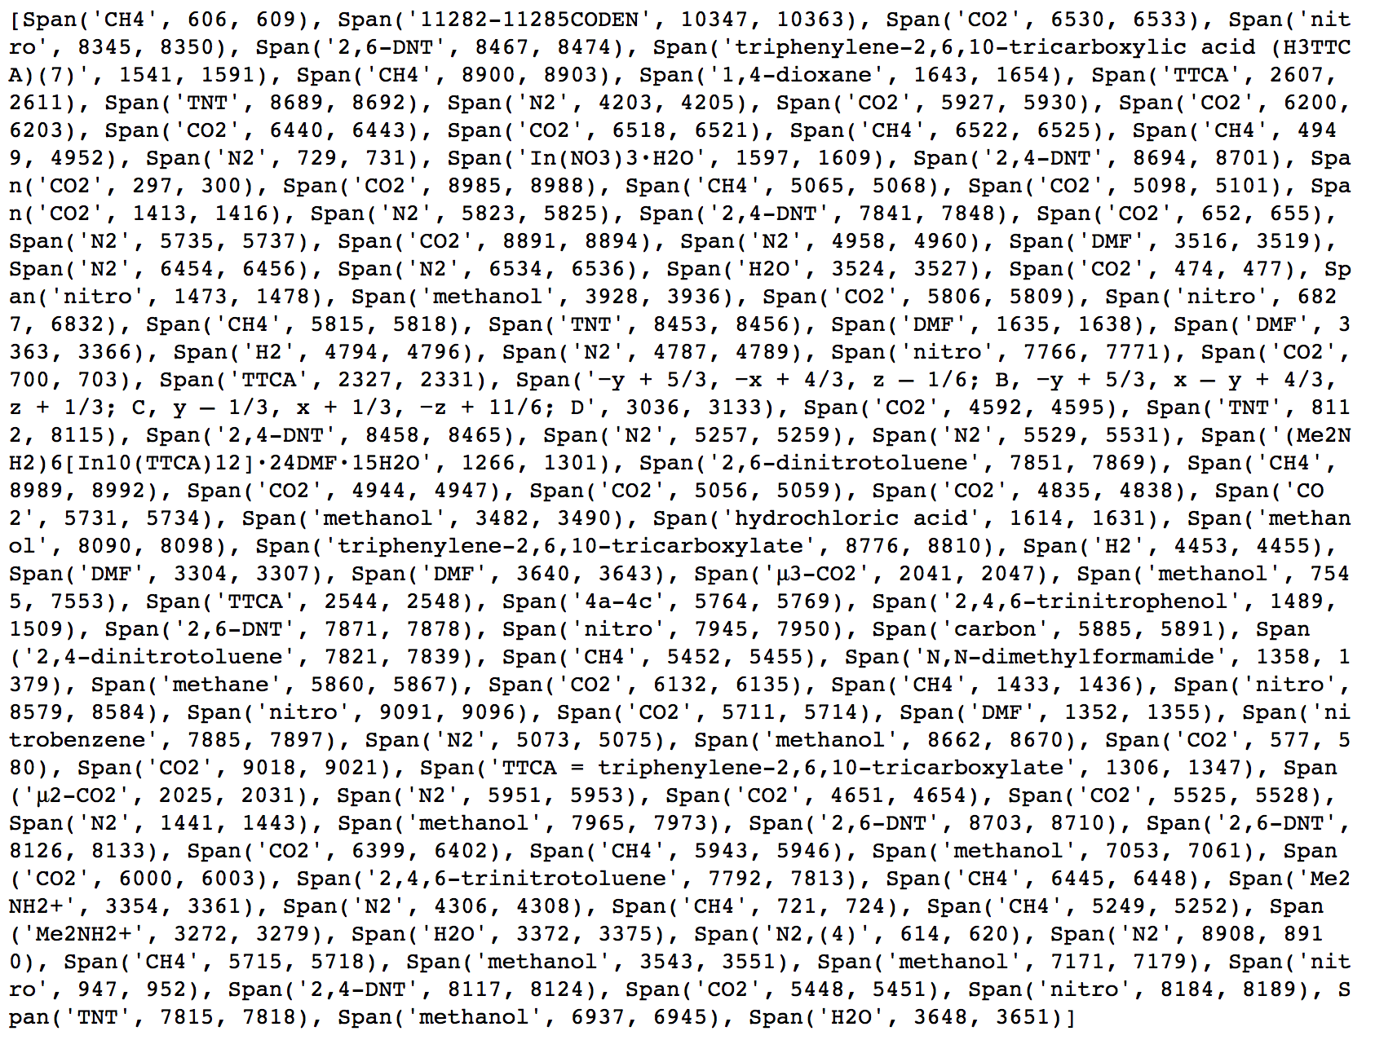
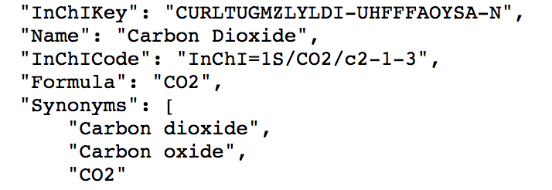
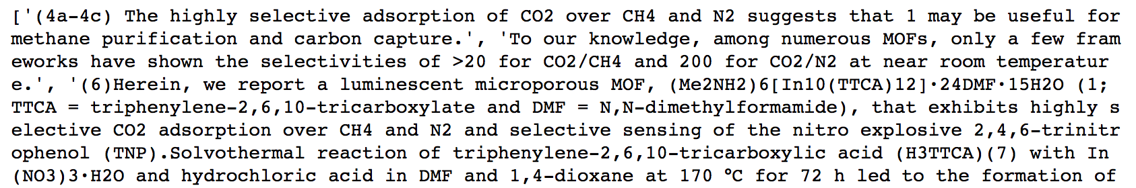
ChemDataExtractor to Find
Adsorbate Names
Cross-Reference with Database
API for Adsorbates
CO₂
4a-4c
Filter for Sentences with Cross-Referenced Chemical Names

Slide 14
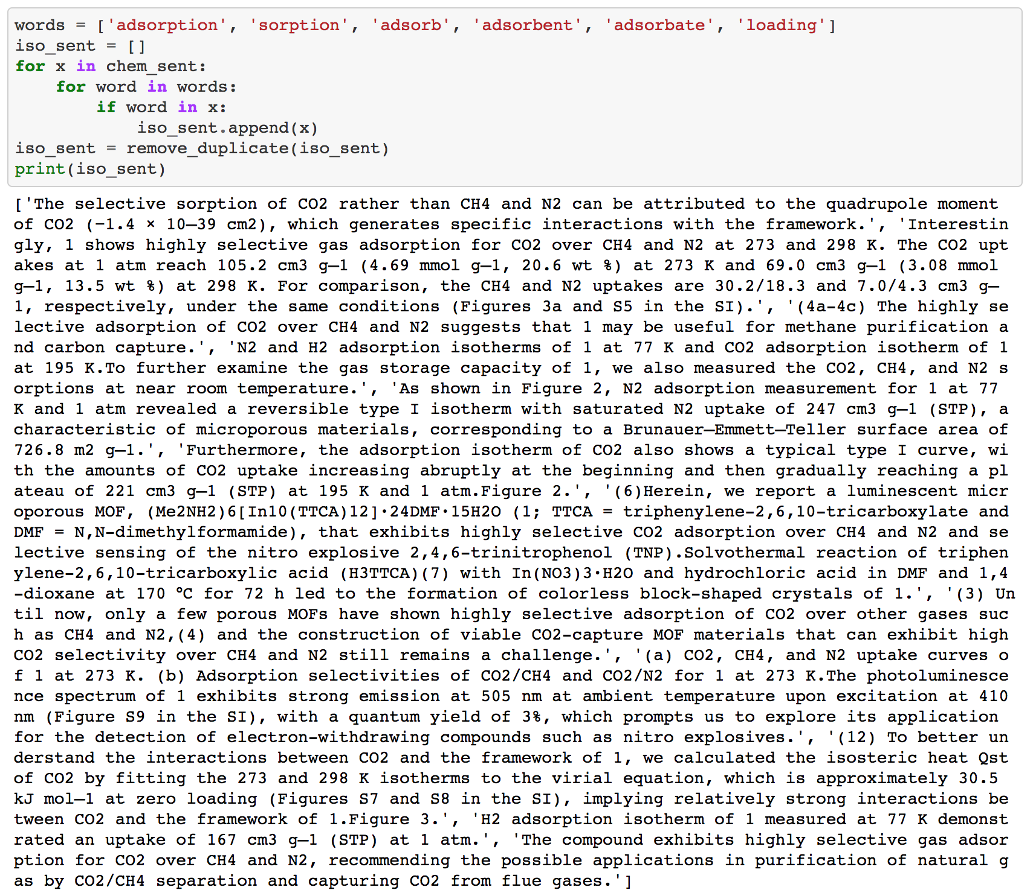
Adsorbates: CO₂, CH₄, N₂
Temperature:
273 K and 298 K
Temperature: 195 K
Location: Figure 2
Temperature:
77 K
Location: Figure 3

Slide 15
Conclusion
The code successfully automatically retrieved the full texts of journal articles
All classifiers tested had higher accuracies than their corresponding null accuracy (Support Vector Classifier and Decision Tree with AdaBoost performed best)
Binary classifiers outperformed the three group classifier
The tertiary classifier gave more comprehensive results
Multicomponent f-score much lower than other classes ⇒ Less data available
Important sentences were successfully detected in the full article ⇒ These sentences contain information about the isotherms

Slide 16
Future work
Automating retrieval and classification are stepping stones to further automation
While I am still at NIST I will continue to work on the natural language processor
This summer the new interns at NIST will use the classifier I developed to expedite the digitization process
Future work on automation: scraping picture captions, extracting metadata, automatic digitization of isotherm

